Slide 1
Entity relationship diagrams

Slide 2
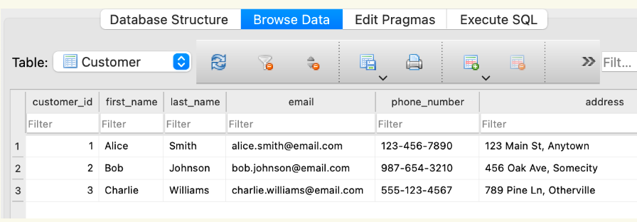
Starter
Identify Primary key , Records and fields

Slide 3
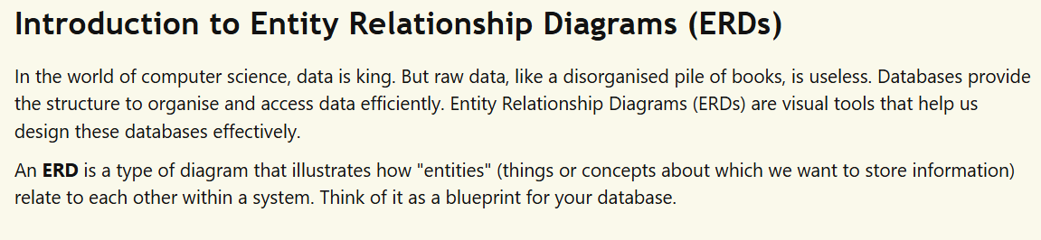

Slide 4
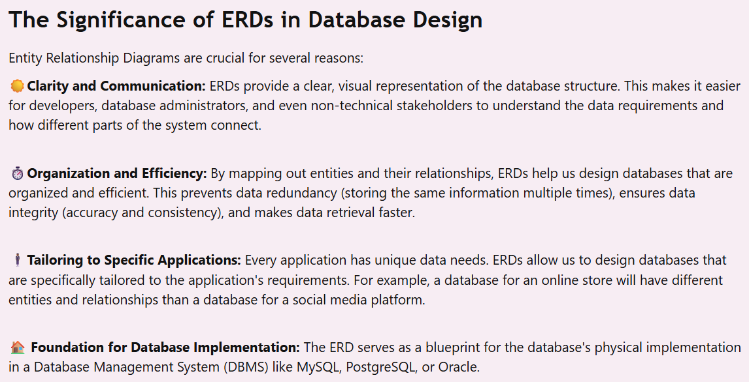

Slide 5
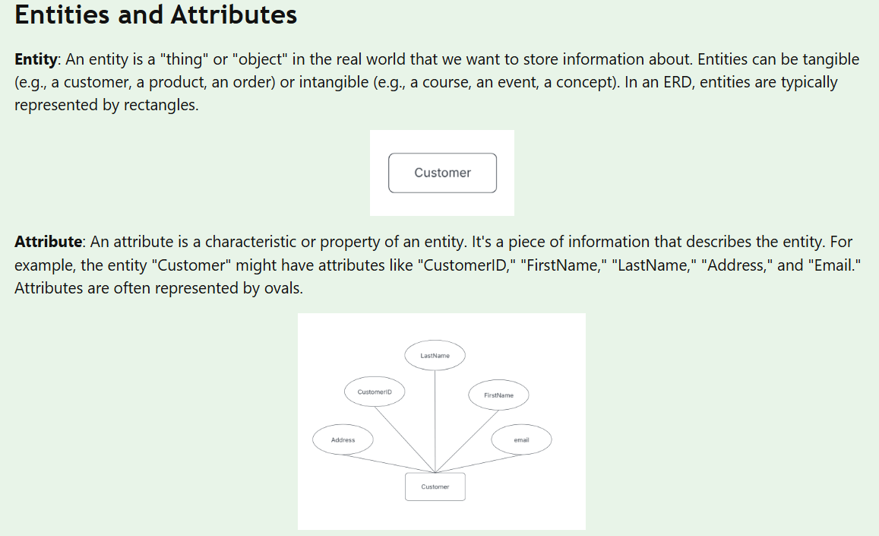

Slide 6
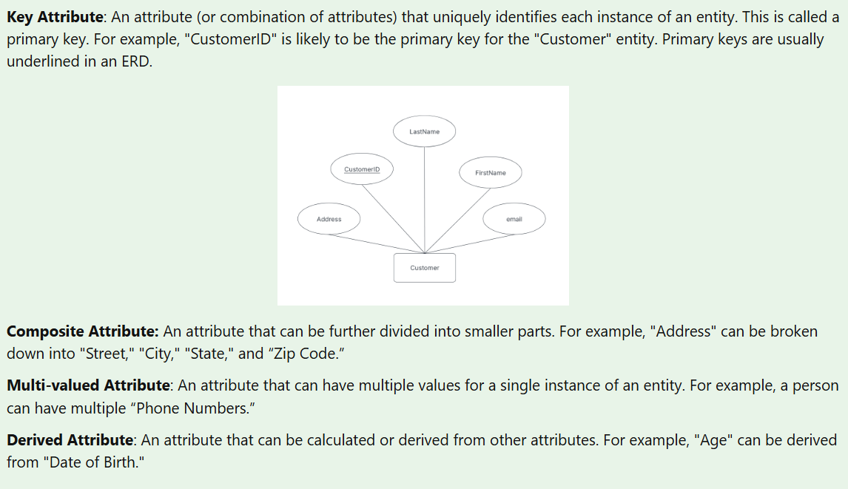

Slide 7
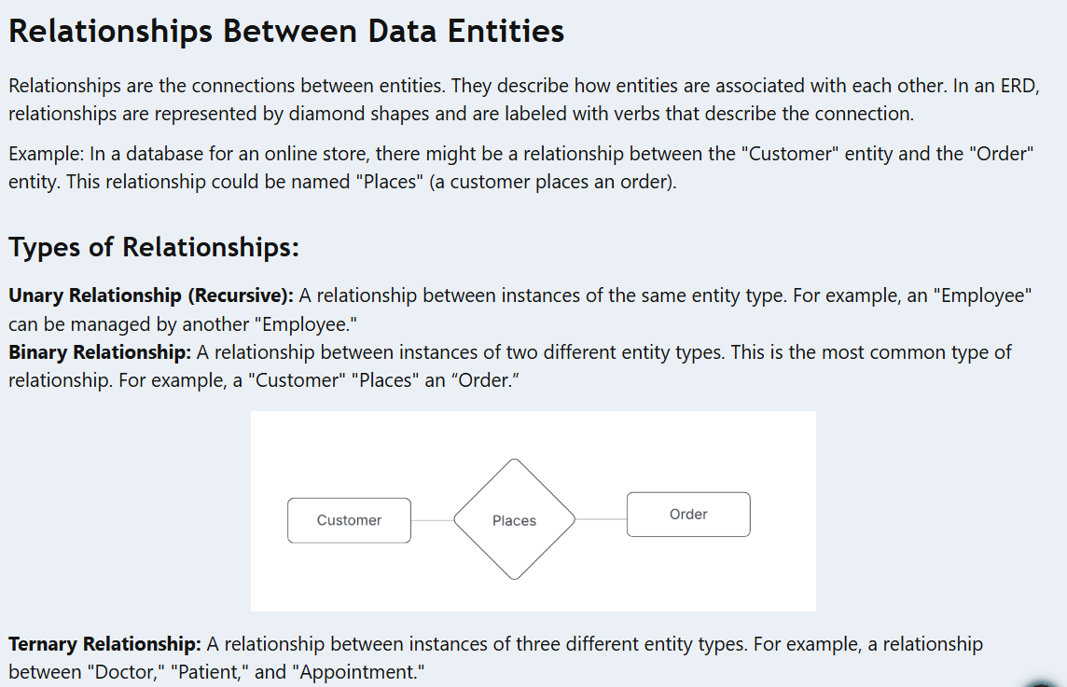

Slide 8
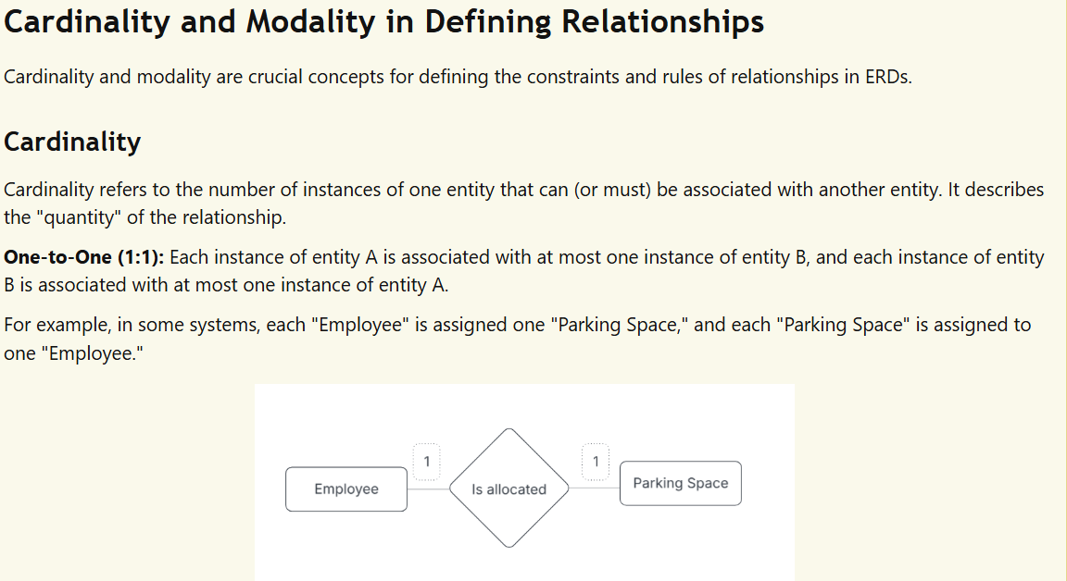

Slide 9
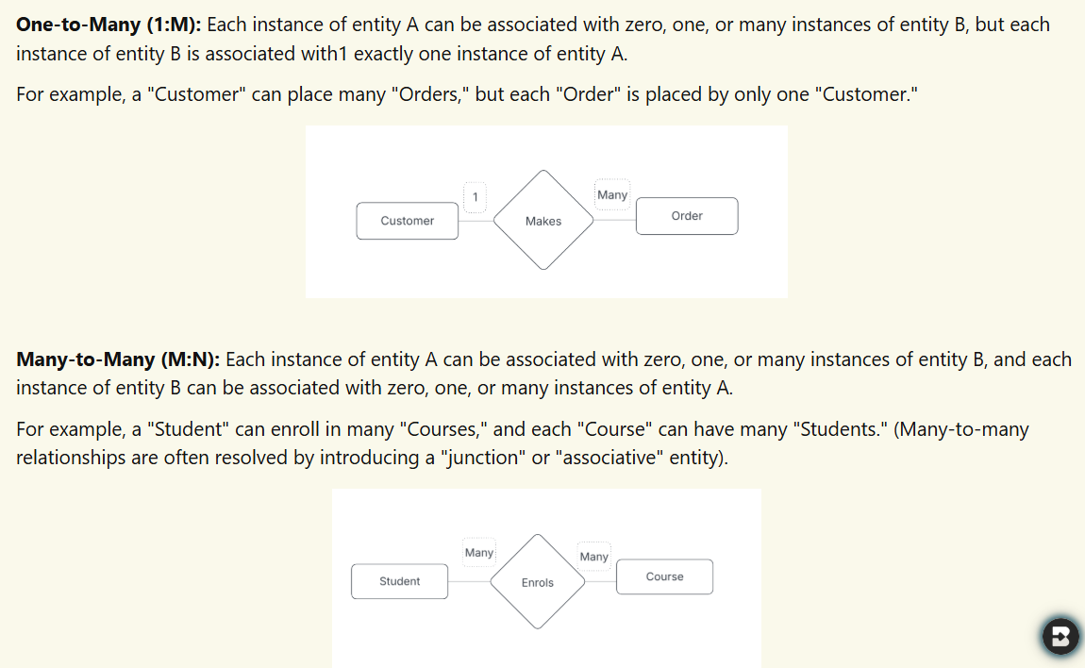

Slide 10
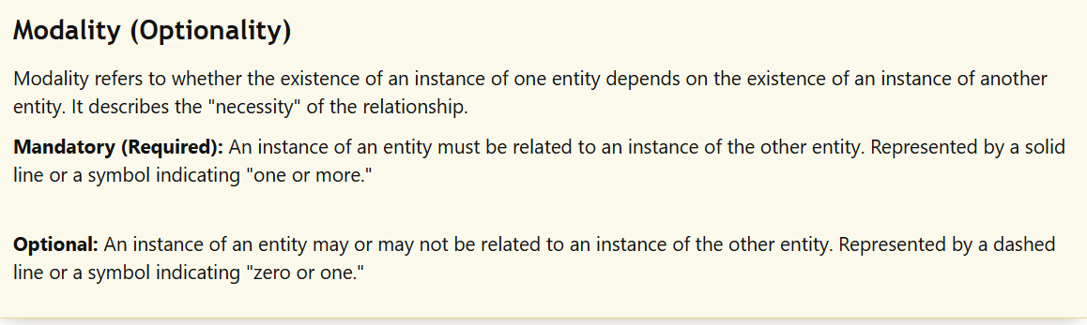

Slide 11
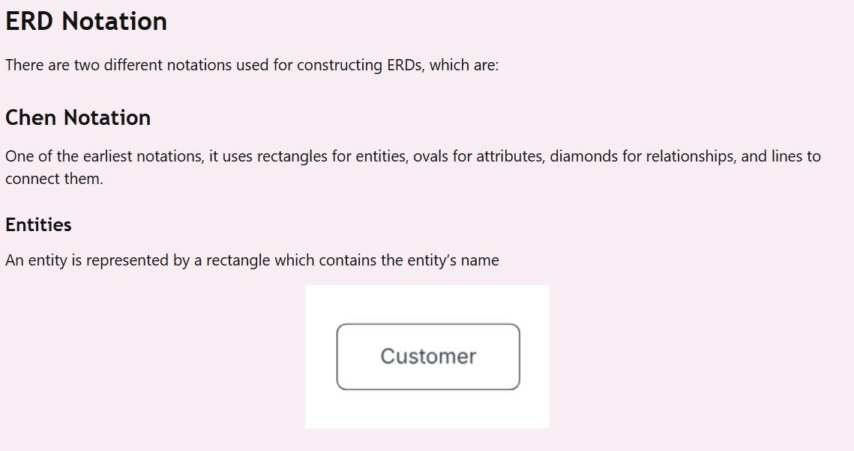

Slide 12
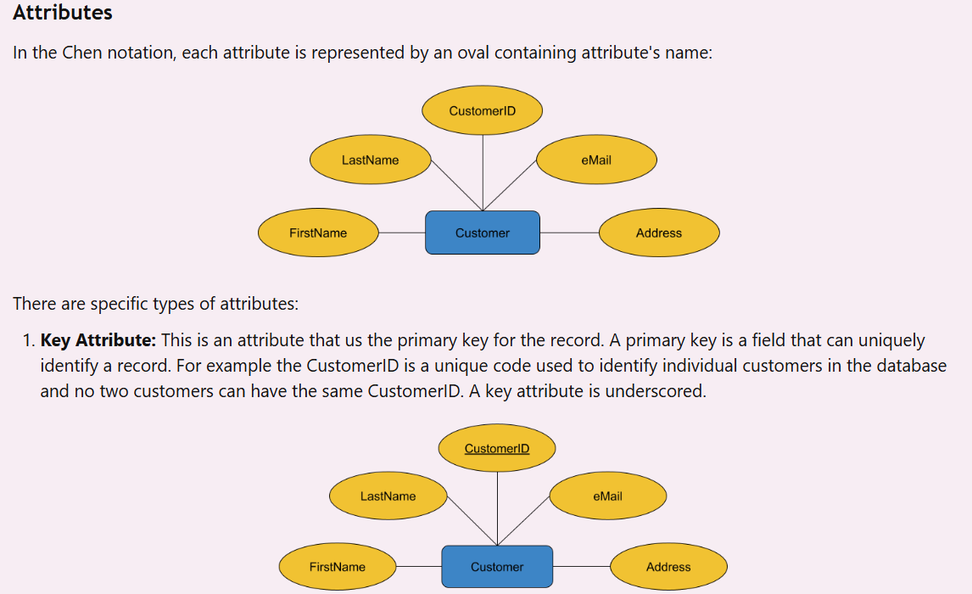

Slide 13
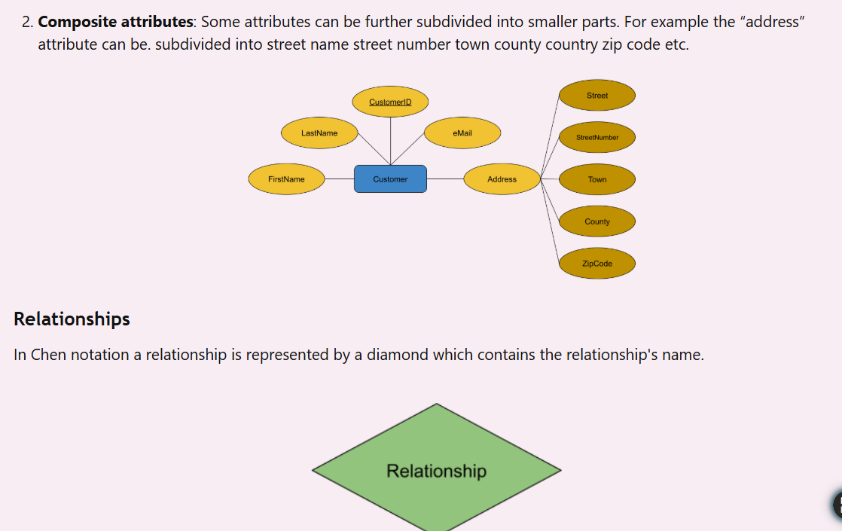

Slide 14
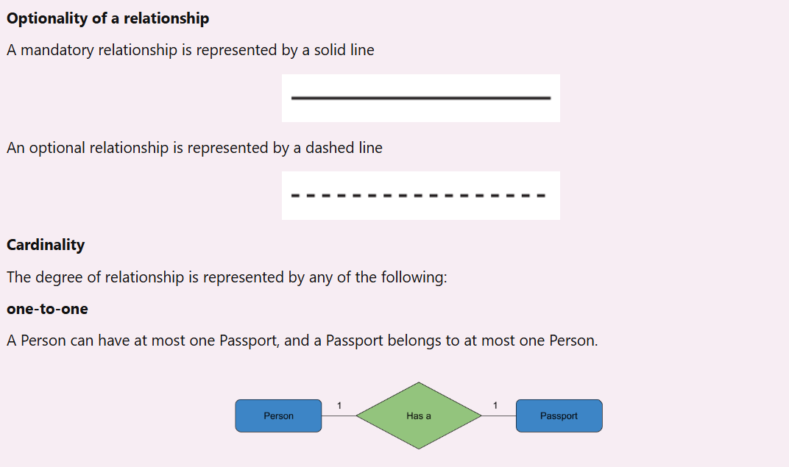

Slide 15
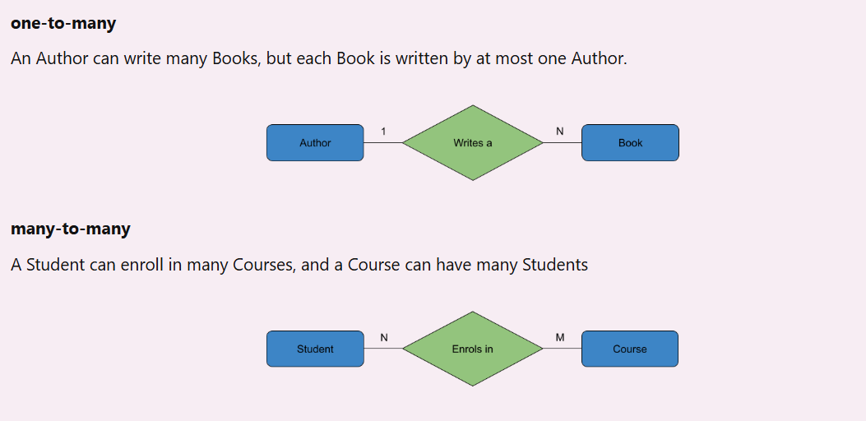

Slide 16
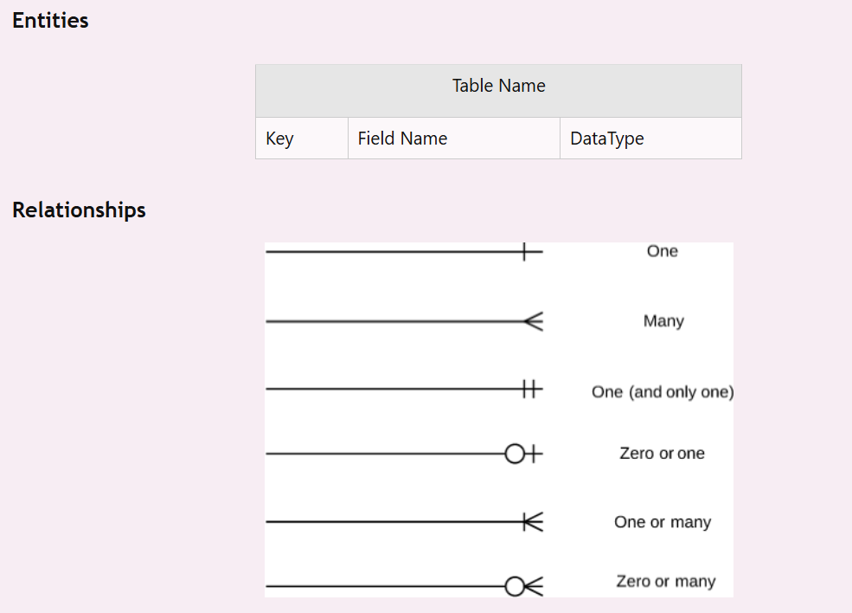
Crow's Foot Notation
A more common notation, especially for relational databases. It uses rectangles for entities, attributes listed inside, and special symbols at the ends of the lines representing relationships to show cardinality and modality (the "crow's feet").

Slide 17
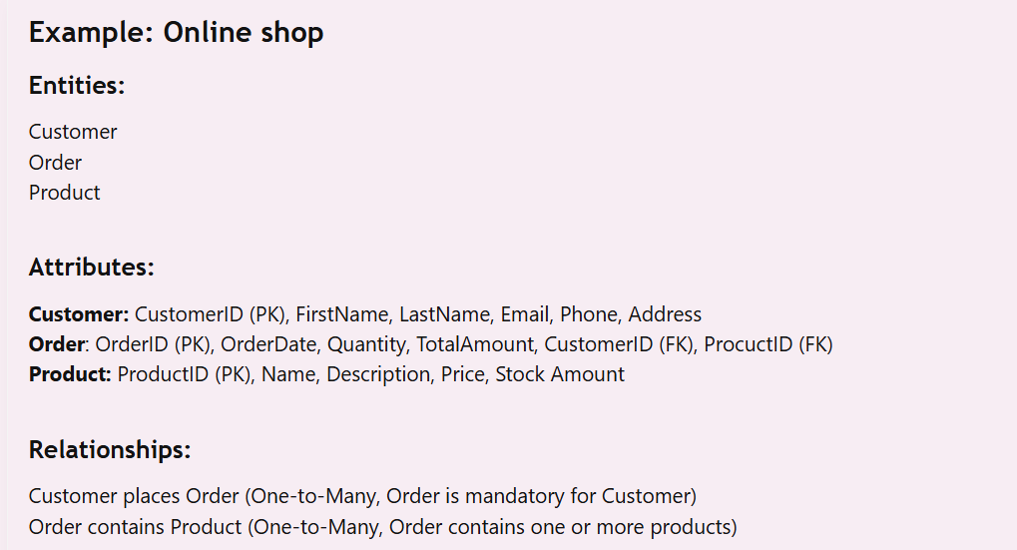

Slide 18
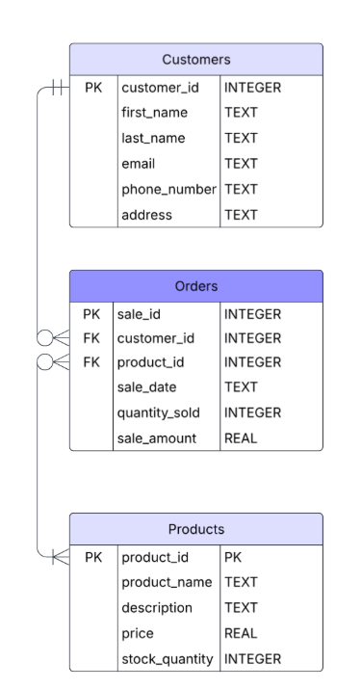
Crows Foot notation
Notice the primary key and foreign key allocation in this diagram. We will look at these later in A 3.2.4 but for now you should understand that these signify fields within an entity that are unique (not duplicated) and can be used to identify each record in a database.
When deciding on the relationships you need to think in terms of the relationship of each entity to the other entity in both directions.
For example in the relationship between the customer and the order.
Customer to Order: There must be at least one customer and there can only be one customer related to an order.
Order to Customer: A customer may have many order but there may also be a customer with zero orders.

Slide 19
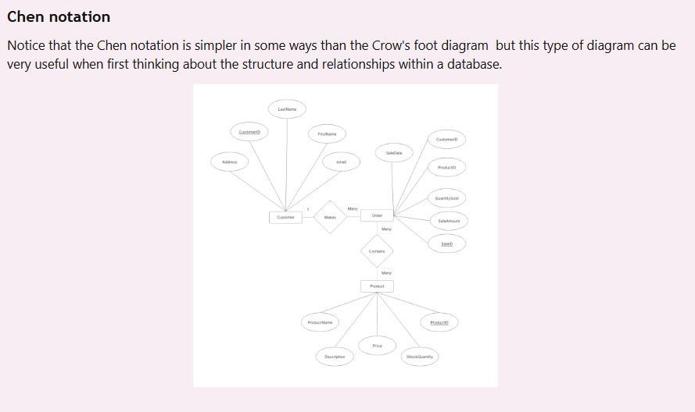

Slide 20
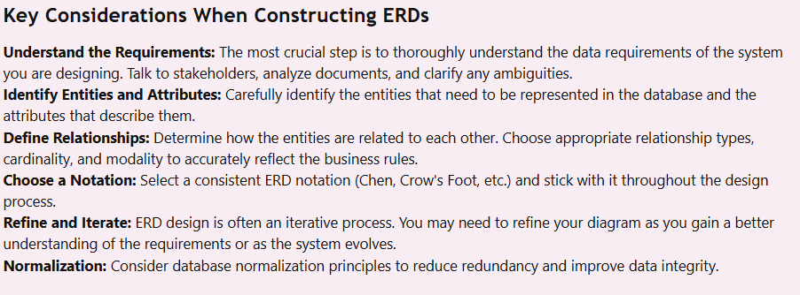

Slide 21
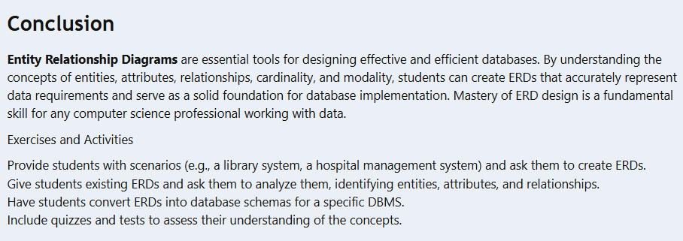

Slide 22
Exam Style Question sheet

